Slide 1
Lung Cancer Susceptibility
Creating a lung cancer risk predictor.

Slide 2
Selected Topic & Reason for Topic
Topic:
Susceptibility to lung cancer based on lifestyle and demographic parameters such as age, gender, alcohol use, genetic risk, and smoking.
Reason for Topic:
Being able to define a patient's risk level of developing lung cancer can help encourage lifestyle changes to reduce risk.
Early detection is key to survival. Detected in its earliest stages it is most treatable, with a cure rate as high as 80-90%.

Slide 3
Description of Data Source
This dataset was sources from Kaggle, a community form of datasets. It shows the demographic and lifestyle data of 1000 lung cancer patients.

Slide 4
Questions to Answer
Which combination of a patient's lifestyle would make them most susceptible to lung cancer?
Which combination of symptoms would indicate the level of a patient’s cancer?

Slide 5
Description of Data Exploration Phase
After defining the questions and topic, we searched for relevant datasets on Google Dataset Search and Kaggle.
We were specifically looking for data on cancer patients and their lifestyle choices leading up to them contracting cancer.
We also searched for data on cancer patient demographics.

Slide 6
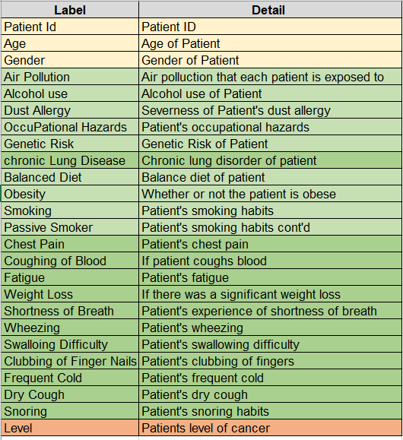
Data Exploration Analysis
Patient Id = P1 - P999
Age = range is 14 - 73
Gender = Male and Female
21 Risk Characteristics = ranked from 1 - 10
Level = “Low”, “Medium”, “High”

Slide 7
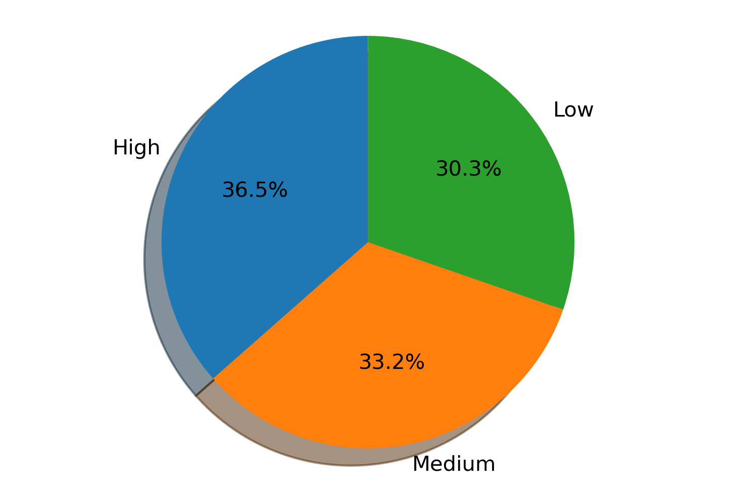
Level
Low = 303 patients
Medium = 332 patients
High = 365 patients

Slide 8
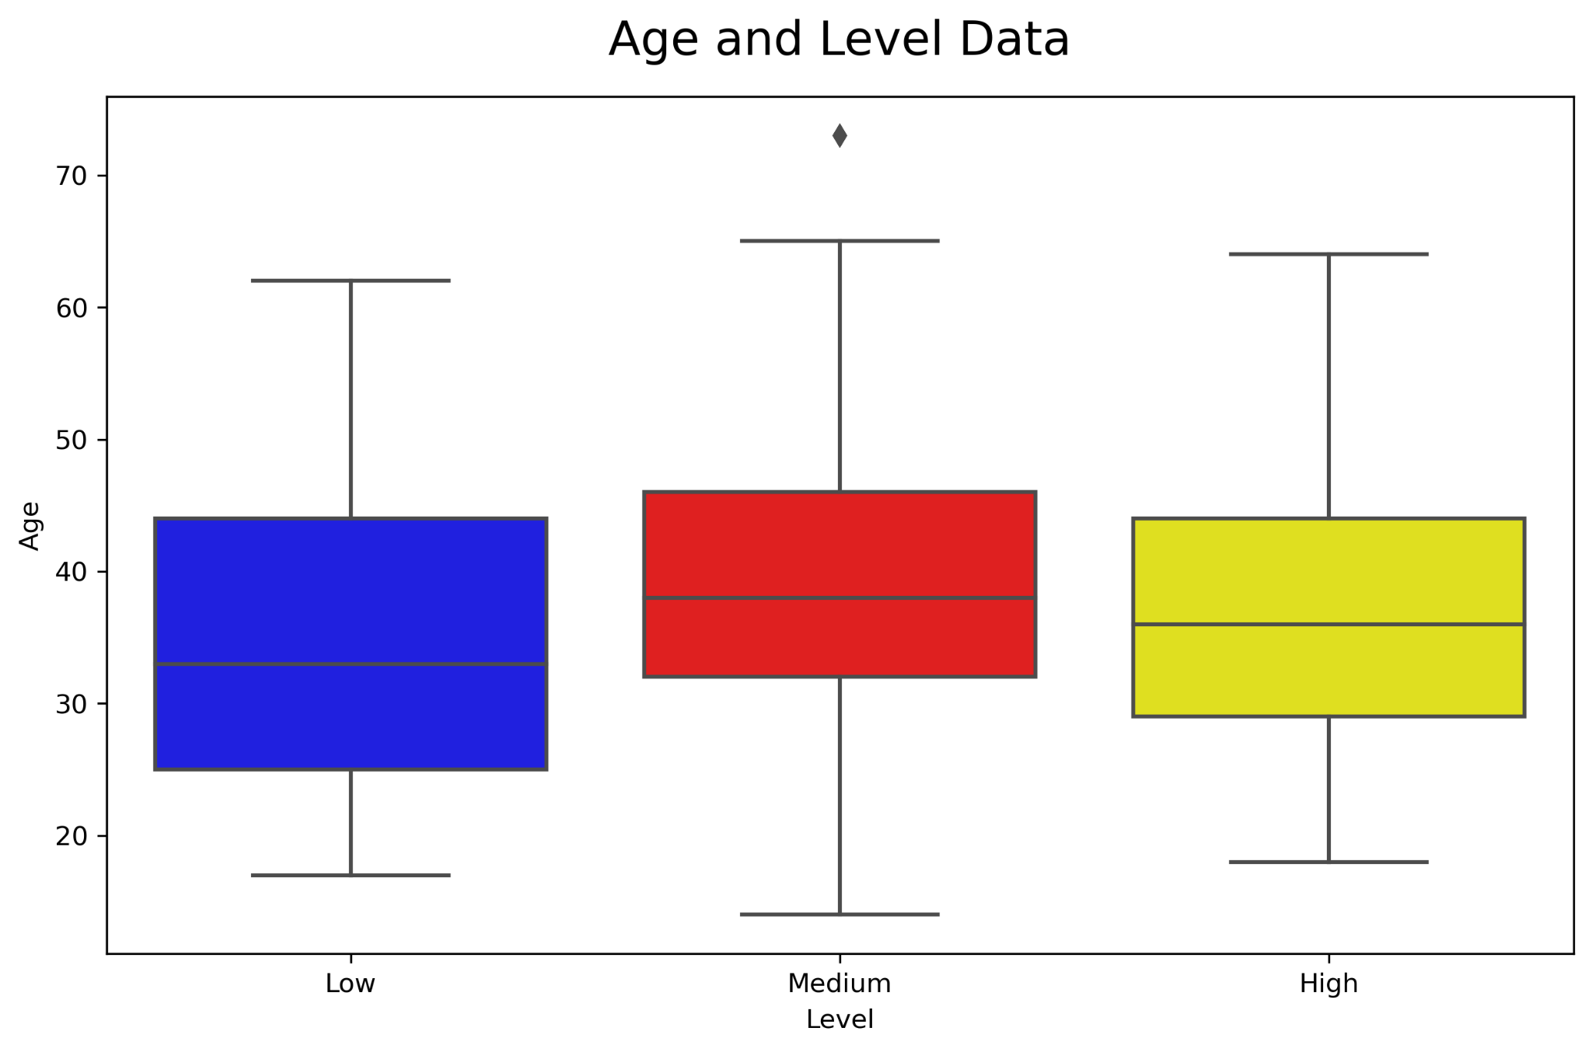
Age
Minimum Age = 14
Maximum Age= 73
Mean = 37
134 patients are over the age of 50

Slide 9
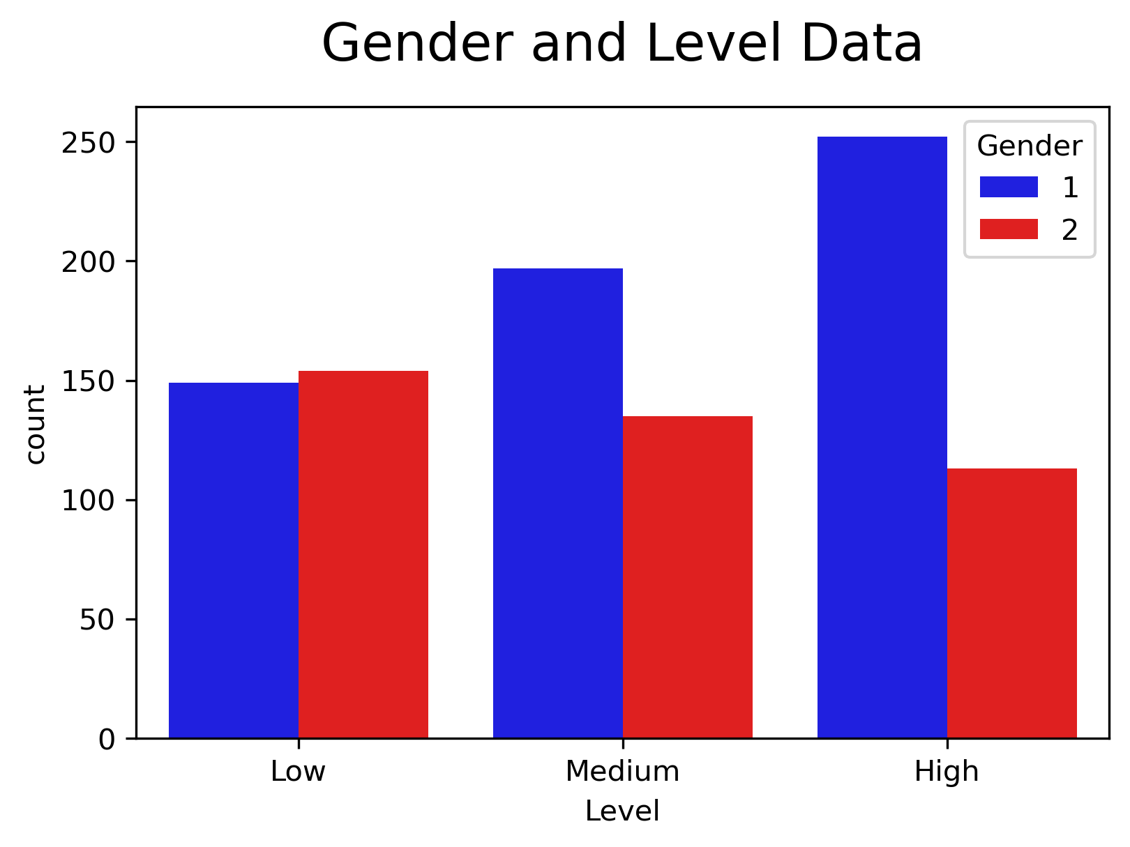
Gender
1 = Male and 2 = Female
The data set consisted of:
598 male patients
402 female patients

Slide 10
Data Visualisation, Cleaning and Preprocessing
Visualisation using Tableau
Decide to use all the data
Re-organise the data using SQL

Slide 11
Technologies, Languages, Tools, Algorithms Used
Python
SQL
HTML
Tableau
Supervised Machine Learning
Support Vector Classifier
Logistic Regression
Decision Tree Classifier

Slide 12
Description of Data Analysis Phase
The dataset was prepared for the machine learning model by cleaning, removing unnecessary information, and converting all data to numerical values.
Statistical information was extracted using python and Excel.
The dataset was visualized using python and Tableau to find and display trends.
The dataset was put through a supervised machine learning algorithm to create a predictive model.
Applied Grid Search to model.

Slide 13
Results of Analysis
Chest pain and coughing of blood were the most prevalent symptoms among patients with high level lung cancer.
A combination of alcohol abuse, bad diet, occupational hazards, and smoking were the most prevalent lifestyle attributes of patients with high level lung cancer.
Created a model that can be used to accurately predict cancer susceptibility based on a patient's lifestyle and symptom information.
Notes:
We were able to create model that accurately predicts a patients susceptibility to cancer and their level of cancer and we used that model to make a survey, which ali demonstrated, and that survey can be used by patients to see where they stand

Slide 14
Recommendations for Future Analysis
Limited dataset. As more data is introduced, the model might have to be reevaluated.
Change scale to 0-5 instead of 0-10.
Notes:
Our dataset only had info on 1000 patients and was relatively clean and easy to work with. As more data is introduced, more obstacles will come with that so the model might have to be re-evaluated.
Currently each of the patient attributes are measured from 0-10, which is a pretty large scale and that brings more variances. It might help to make it a 0-5 scale instead to get rid of some variances and make it easier as more data is introduced.

Slide 15
Anything The Team Would Have Done Differently
Try to make age and gender more relevant factors to make our model more useful.
Notes:
Although we had age and gender info, they ended up not being relevant or usable factors in our analysis so maybe we could have made ranges using buckets to help make our model more useful.

